Slide 1
ELECTROMAGNETIC FIELD THEORY Course Code: ECE207 By: Shakti Raj Chopra

Slide 2
Books
Text Book:
1. PRINCIPLES OF ELECTROMAGNETICS
By - MATTHEW N.O. SADIKU, 4th 2009 OXFORD UNIVERSITY
PRESS, INDIA
Reference Book:
1. ELECTROMAGNETIC WAVES AND RADIATING SYSTEMS
By - EDWARD C. JORDAN 5th PRENTICE HALL

Slide 3
DIFFERENTIAL LENGTH, AREA, AND VOLUME
Cartesian Coordinates,
Differential displacement is given by:

Slide 4
Differential normal area is given by,

Slide 5
Differential volume is given by:
Cylindrical Coordinates
Differential displacement is given by:

Slide 7
Differential normal area is given by:
Differential volume is given by:

Slide 8
Spherical Coordinates
The differential displacement is
The differential normal area is

Slide 9
The differential volume is

Slide 10
Del Operator
The del operator is the vector differential operator. In Cartesian coordinates,
This vector differential operator, otherwise known as the gradient operator, is not a vector in itself, but when it operates on a scalar function, for example, a vector ensues. The operator is useful in defining

Slide 11
Gradient of a Scalar:
Imagine a landscape with hills and valleys. The gradient, denoted by ∇, tells you how steep the "hill" of a quantity (like temperature,pressure, or voltage) is at a particular point and in which direction you'd go to climb the steepest part.
In electromagnetism, the gradient of the electric potential (voltage) represents the electric field, pointing in the direction of greatest increase in potential.
Divergence of a Vector:
Think of a flowing river. The divergence, denoted by ∇⋅, measures how much the water is "spreading out" or "squeezing together" at a point. A positive divergence means the flow is spreading, while a negative divergence means it's converging.
In electromagnetism, the divergence of the electric field tells you if there are any sources or sinks of electric charge at a point. A non-zero divergence indicates the presence of charges.

Slide 12
Curl of a Vector:
Imagine a spinning object. The curl, denoted by ∇×, measures how much the object is "twisting" around a point. A high curl means there's significant rotation, while a zero curl means no rotation.
Laplacian of a Scalar:
This combines the effects of the gradient and divergence. It tells you how rapidly the "hilliness" of a quantity changes around a point,considering both steepness and spreading/convergence.
Laplacian of a Vector:
This is less commonly used, but it applies the Laplacian operator to each component of a vector field.

Slide 13
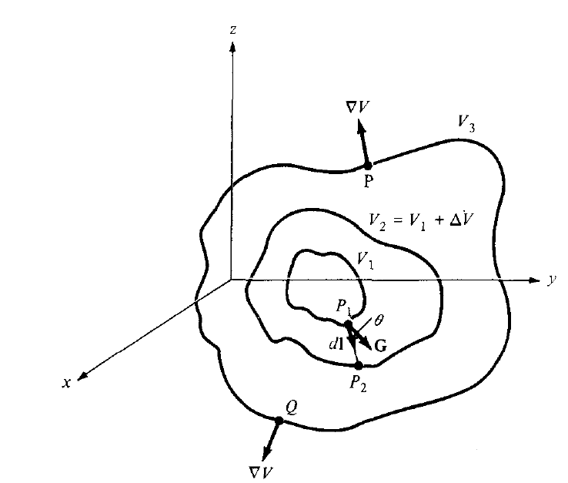
GRADIENT OF A SCALAR
The gradient of a scalar field V is a vector that represents both the magnitude and the direction of the maximum space rale of increase of V.

Slide 14
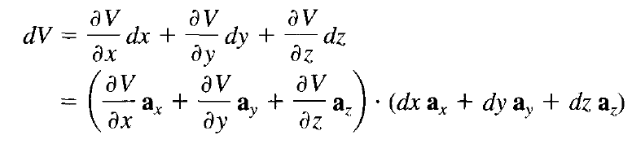
A mathematical expression for the gradient can be obtained by evaluating the difference in the field dV between points P1 and P2 of Figure where V,, V2, and V3 are contours o which V is constant. From calculus:
Let

Slide 15
By definition, G is the gradient of V. Therefore
for cylindrical coordinates,
and for spherical coordinates,

Slide 16
Divergence
The divergence of A at a given point P is total outward flux per unit volume as the volume shrinks about P.

Slide 17
Divergence

Slide 18
Divergence

Slide 20
Divergence
In Circular Coordinate
In Spherical Coordinate

Slide 21
Divergence Theorem

Slide 22
Divergence Theorem: Proof

Slide 23
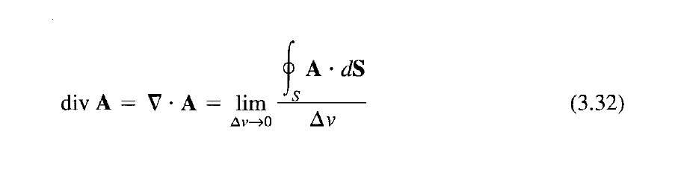
Since the outward flux to one cell is inward to some neighboring cells, there is cancellation on every interior surfaces
So the sum of the surface integrals over Sk's is the same as the surface integral over the surface 5. Taking the limit of the right-hand side of eq. (3.43) and incorporating eq. (3.32) gives ie Divergence

Slide 24
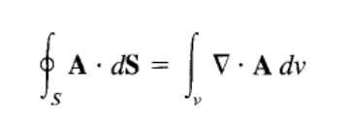
Divergence Theorem
That is Divergence Theorem.
Using the Divergence Theorem, we can convert the surface integral to volume integral using Divergence.

Slide 25
Have a look at following URL
http://llovesumi.tripod.com/menu.htm

Slide 26
Curl of a Vector Field

Slide 27
Curl: Derivation

Slide 31
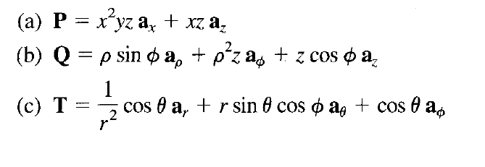
Determine the Curl

Slide 32
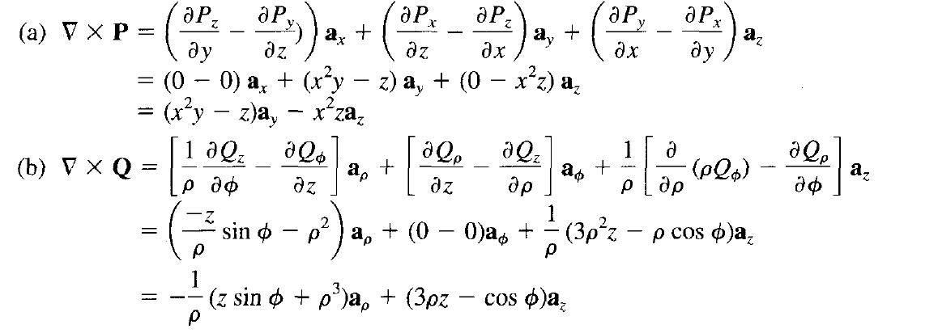
Solution

Slide 33
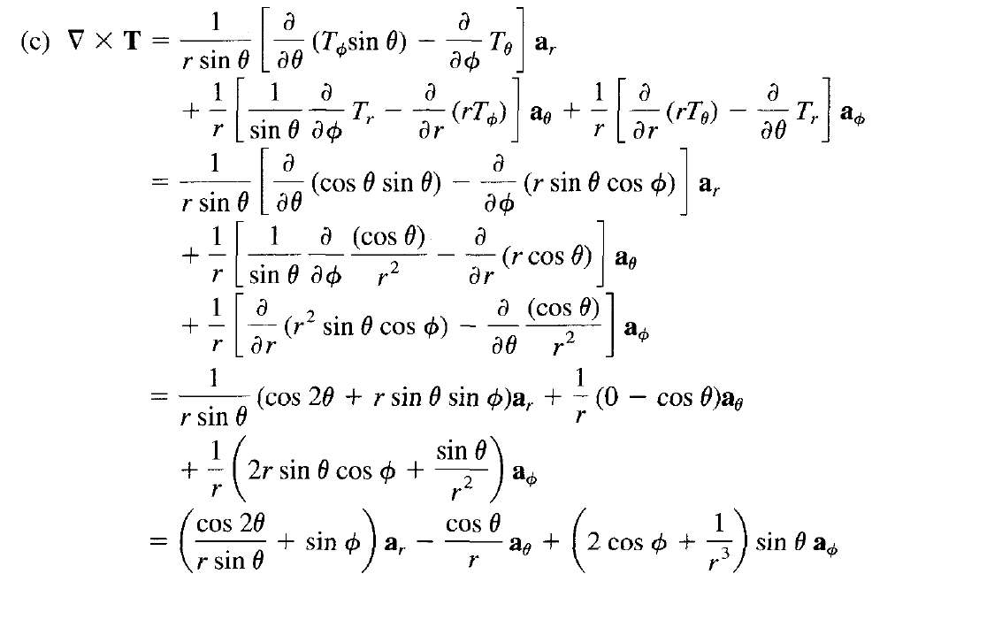

Slide 34
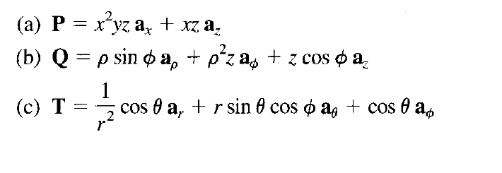
Determine the Curl

Slide 35
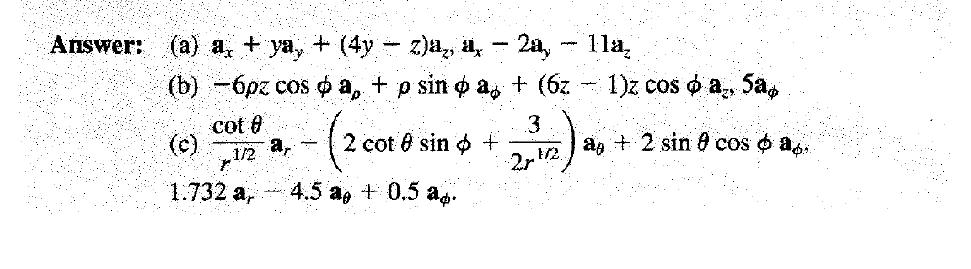
Ans

Slide 36
Stokes’ Theorem

Slide 37
Stokes’ theorem

Slide 38
Stokes’ theorem

Slide 39
LAPLACIAN OF A SCALAR
It is a single operator which is the composite of gradient and divergence operators. This operator is known as the Laplacian

Slide 40
Laplacian of a Scalar

Slide 41

Laplacian of Scalar Field
Poisson’s Equation

Slide 42
Laplacian of a Vector Field

Slide 43
Thanks a lot !

